Slide 1

Migration to AWS Cloud
Joshua Kovacevich

Slide 2
Overview
Docker Compose for Containerization and Orchestration
Benefits of going serverless
Lambda APIs
Mongo vs Dynamo as Database Solutions
Elasticity in the Cloud and Cost
AWS IAM for web application security

Slide 3
Docker Compose
What is docker compose?
Docker Compose is a tool that allows you to string together multi-container applications that allows internally managed containerization and communication while handling much of the load balancing required in multi-factor applications.
How do we use containerization?
Containers are compartmentalized application that are run in a consistent environment and can easily be spun-up, shut down, or replaced. Typically, the goal of a container is to handle one portion of the application such as a front-end, database instance, or backend “server” logic.
What value does Docker Compose provide?
Docker compose removes some of the complexity of building and deploying full stack applications and can help (with orchestration) to manage the application from development to production. When containers crash or fail, they can seamlessly be replaced with another container providing unsupervised reliability.

Slide 4
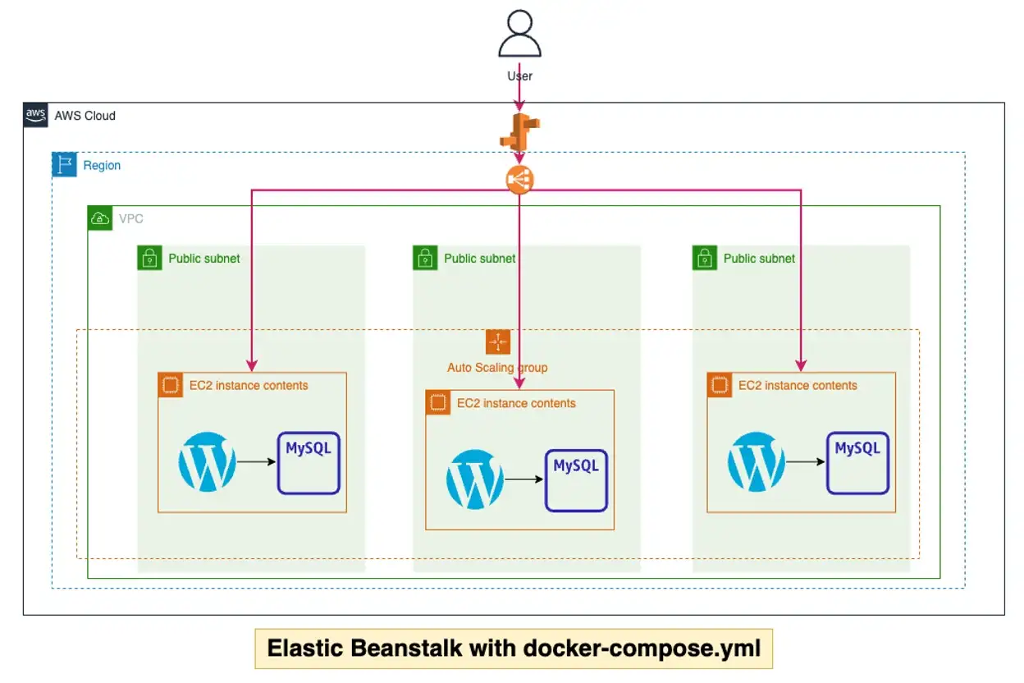
(Muharrem K, 2022)

Slide 5
Why go Serverless?
What does serverless actually mean?
Contrary to what the name suggests the application is still running on a server in a sense, though the servers are widely distributed and the exact server running the application can change depending on availability giving increased reliability and minimize downtime.
How to leverage S3 storage?
S3 is a storage schema that allows data to be uploaded to the cloud and remain reliably accessible regardless of location. S3 storage has different tiers of storage that can range to data being accessed constantly to long term low traffic storage for data in archives that needs to be accessible and maintained for long periods of time. The S3 system allows quick access to data with a reliability that could only be matched locally by having multiple synced local storage drives taking time and money and dependent on the resources of the facility they are stored in.

Slide 6
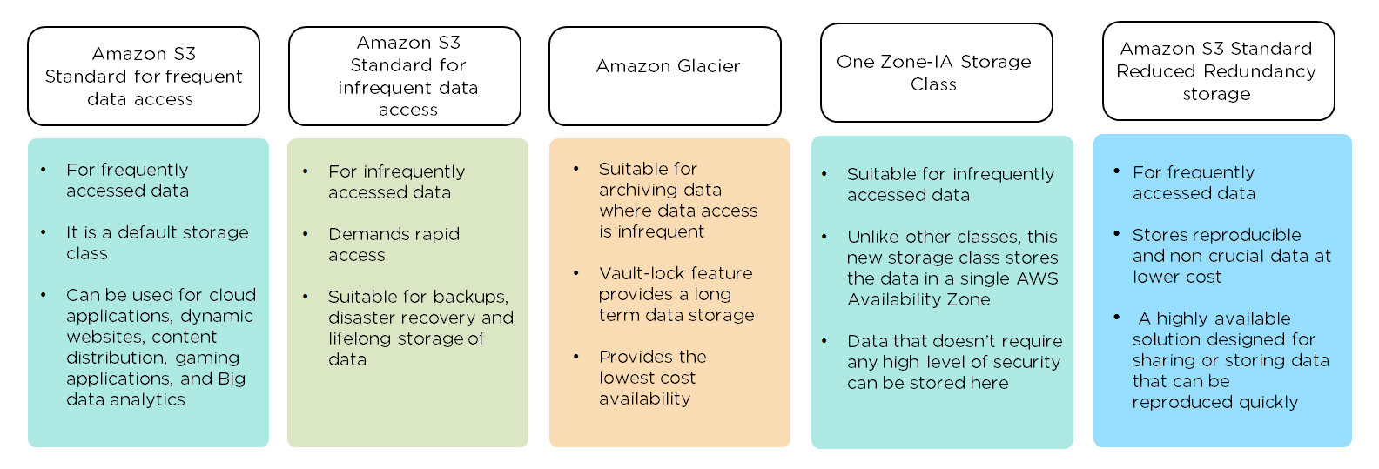
(Arun, 2020)

Slide 7
Lambda APIs
What are Lambda functions?
Lambda Functions are event driven pieces of code that are run without provisioning or managing servers that are charged by their usage and rather than server focused services.
How do they work?
Lambda functions work by being instanced and ran on call with just in time runs. The code is uploaded and deployed then await a calling event to communicate with front and back ends, compute and return results or handle backend processing.
How to integrate the front and back end with lambda?
Lambda functions can be called by the API Gateway to retrieve or send information to backend services and databases and return results to the calling front end applications for display information. Essentially, lambda functions can be placed in your application to handle all communication between the front and backend with the help of and API Gateway.

Slide 8
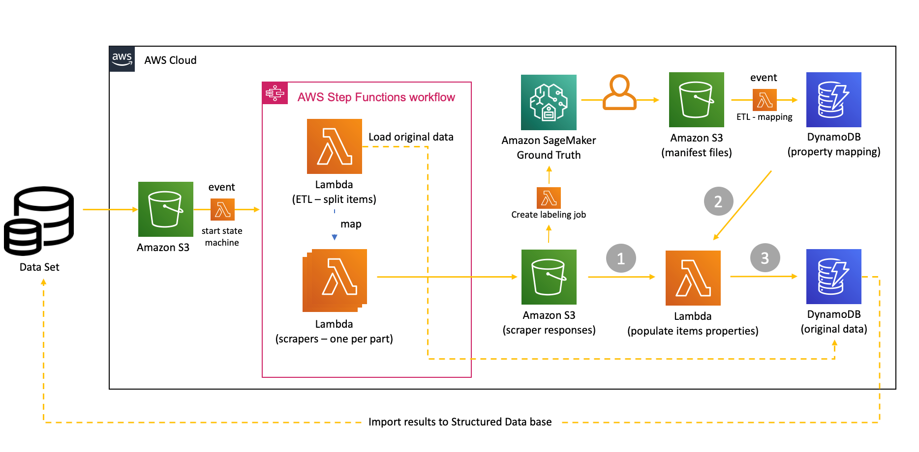
(Amazon, 2021)

Slide 9
Mongo vs Dynamo
What are the major differences between these Databases?
Both Mongo and Dynamo are NO SQL databases that share a fair amount of functionality. While Mongo has multiple collections and Schemas in a database Dynamo uses a Single Table design for different data collections. Dynamo uses primary keys to access data entries and can have secondary partition keys as well which is a bit different than the query capabilities of MongoDB.
How are Dynamo Queries performed?
As mentioned above, Dynamo uses Primary and secondary keys to index data entries which simplifies query operations, though these simplifications can result in more constrained searches and indexing.
How we make this database work?
To build a Dynamo Database table one needs only to create the table with an appropriate name for reference and set up the primary and optional secondary sort keys. Once these keys are set up they become mandatory, whereas other fields are option in theory, in practice it makes more sense to use standard data schemas in most use cases.

Slide 10
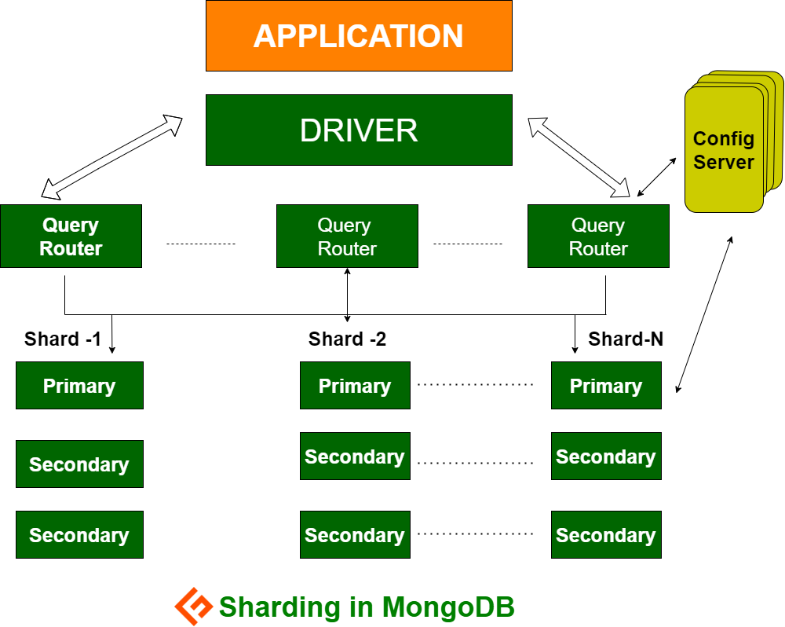
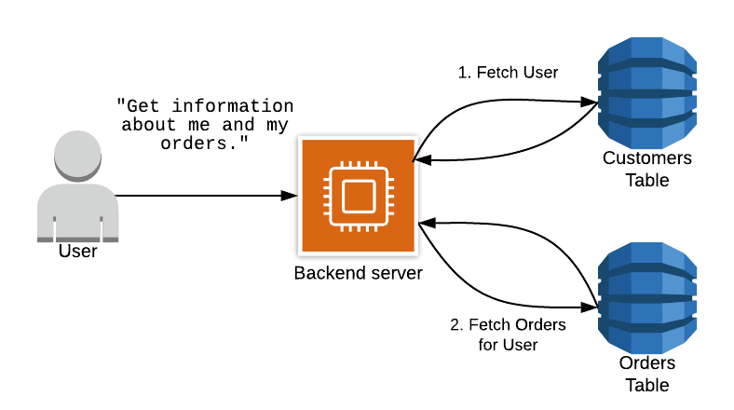
Dynamo DB
(Ali, 2020)
(The What, Why, and When of Single-Table Design with DynamoDB, 2020)

Slide 11
Elasticity and the Pay Model
What do I mean by Elasticity?
Elasticity in the cloud refers to “The ability to acquire resources as you need them and release resources when you no longer need them. In the cloud, you want to do this automatically.” (Amazon, 2020)
This means that you can scale-up down or sideways as needed, spin up resources when needed and shut them down if it is unlikely, they will be needed for periods of time. This flexibility effectively allows the practice of min-maxing resource utilization in the cloud, allowing you to only pay for what you absolutely need, when you absolutely need it.
The Pay Model
AWS offers a pay for use model where you are only charged for what you use when you use it. Additionally, based off use case and storage requirements allows you to pay different rates based on data usage and resource utilization, where high resource utilization costs more and streamlined efficient code can lead to significant savings whereas with server systems you pay for resources regardless of utilization.

Slide 12
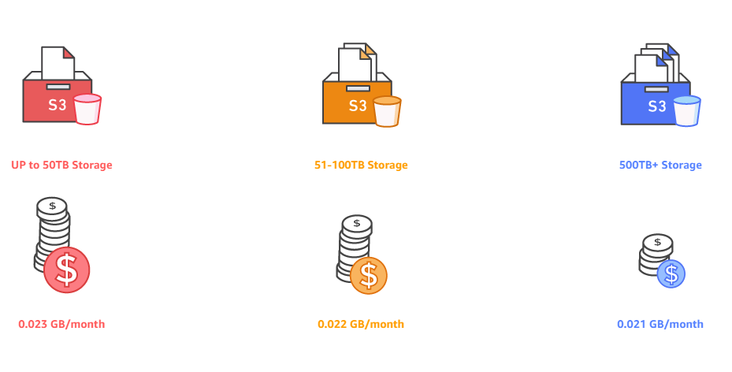
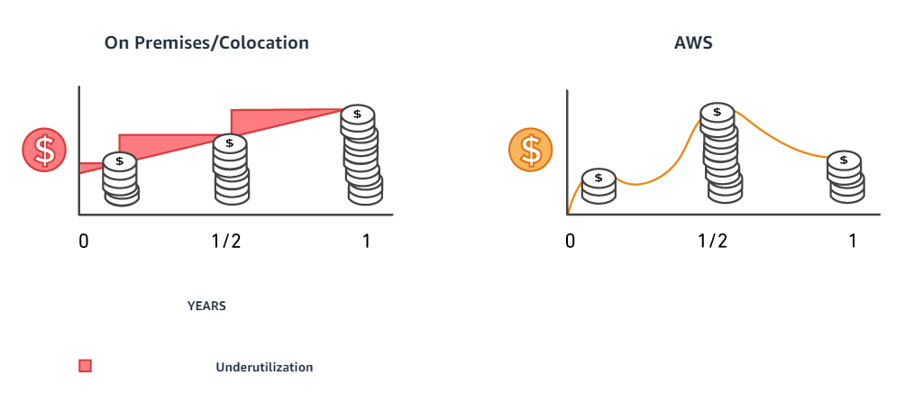
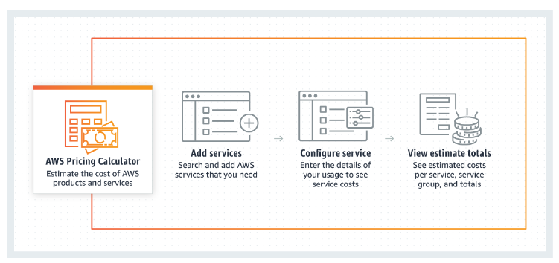
(AWS Pricing Calculator, 2022)

Slide 13
IAM in AWS
What is IAM?
IAM standing for Identity and Access Management is a built-in feature set for AWS that allows you to control security and access to application components and data on case by cases basis or through custom policies you create.
How roles and policies work?
Roles, as one might expect refers to the roles a user may have on your application and can be as restrictive or permissive as you desire with small easy modifications to the role set. Policies are how these modifications are made and while having significant built-in options can also be implemented in simple and customizable policies, for specific or broad categories of users and functionalities.
Custom Policy Creation
As mentioned above, Custom policies can be created to fit your applications needs. Maybe you want authentication or user privileges for certain API functionality, simply create a policy with a few easy steps, add it to those API endpoints and you are ready to go.

Slide 14
IAM in AWS (cont…)
Securing the Endpoints
By default, endpoints are set to private and have no accessibility to outside applications. By enabling policies and permissions for roles and applications, or public access a user can secure endpoints for the front-end, back-end and API so that they communicate in the way you desire and in no other, unexpected ways.
S3 Bucket Security
S3 Buckets are similarly created private by default and can be customized to only allow access from certain user roles, the public, or only from back-end services that you control and manage.

Slide 15
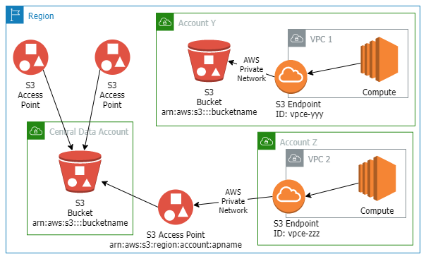
(Freeman, 2020)

Slide 16
Wrap-up/Final Comments
AWS allows an elastic application that only includes what you think are necessary to run and secure your application, without the need to micro-manage server configurations, load balancers, and other time intensive and easy to mess up settings.
The pay model and can allow your efficient code to save you money and CPU cycles as you only pay for what you need. While writing the absolutely most efficient code is not necessary to make the AWS pay model competitive to other server-based options, highly efficient code can drastically reduce costs related to running your application and hosting it online. This is all while allowing you to scale up and down to whatever size in necessary for your application on demand.
The API Gateway allows for easy API setup and modification with relatively low time costs. By far one of the easiest to set up API options that works from development to production with only minor policies/permission changes in the process.

Slide 17

(Rubber Duck Advisors, 2022)

Slide 18
Sources
Ali, A. (2020, July 4). MongoDB Sharding: Praktische Schritt-für-Schritt-Anleitung. Geekflare. https://geekflare.com/de/mongodb-sharding/
Amazon. Elasticity - AWS Well-Architected Framework. (2020). Amazon.com. https://wa.aws.amazon.com/wellarchitected/2020-07-02T19-33-23/wat.concept.elasticity.en.html
Amazon. Serverless Architecture for a Structured Data Mining Solution | Amazon Web Services. (2021, October). Amazon Web Services. https://aws.amazon.com/blogs/architecture/serverless-architecture-for-a-structured-data-mining-solution/
AWS Pricing Calculator. (2022). Calculator.aws. https://calculator.aws/#/?nc2=pr&refid=20f7ad0f-1143-49ef-9e42-2ec60c2fed5e
Arun, R. (2020, April 29). What is AWS S3: Overview, Features and Storage Classes Explained. Simplilearn.com; Simplilearn. https://www.simplilearn.com/tutorials/aws-tutorial/aws-s3
Freeman, J. (2020, April 8). Protect data in the cloud with S3 Access Points and S3 Endpoints. Freemansoft.com; Blogger. https://joe.blog.freemansoft.com/2020/04/protect-data-in-cloud-with-s3-access.html
Muharrem K. (2022, March 8). AWS Elastic Beanstalk with docker-compose.yml file - adessoTurkey - Medium. Medium; adessoTurkey. https://medium.com/adessoturkey/aws-elastic-beanstalk-with-docker-compose-yml-file-ae5958569b2f
‌The What, Why, and When of Single-Table Design with DynamoDB. (2020). Alexdebrie.com. https://www.alexdebrie.com/posts/dynamodb-single-table/
Rubber Duck Advisors. (2022). Dribbble. https://dribbble.com/shots/19707224-Rubber-Duck-Advisors

